Slide 1
Automation with Python
By Shubh

Slide 2
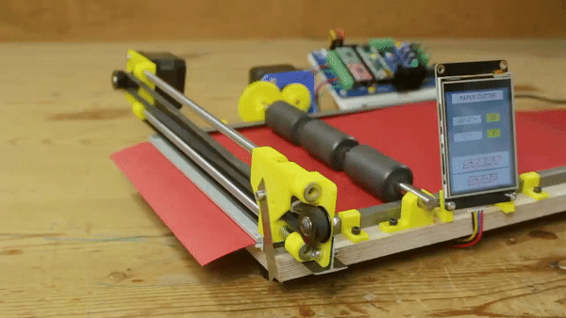
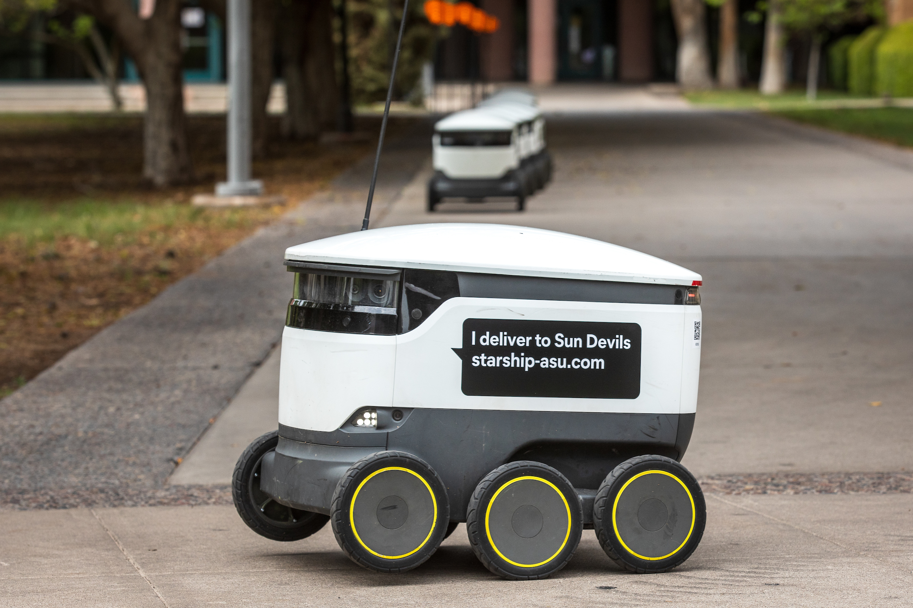
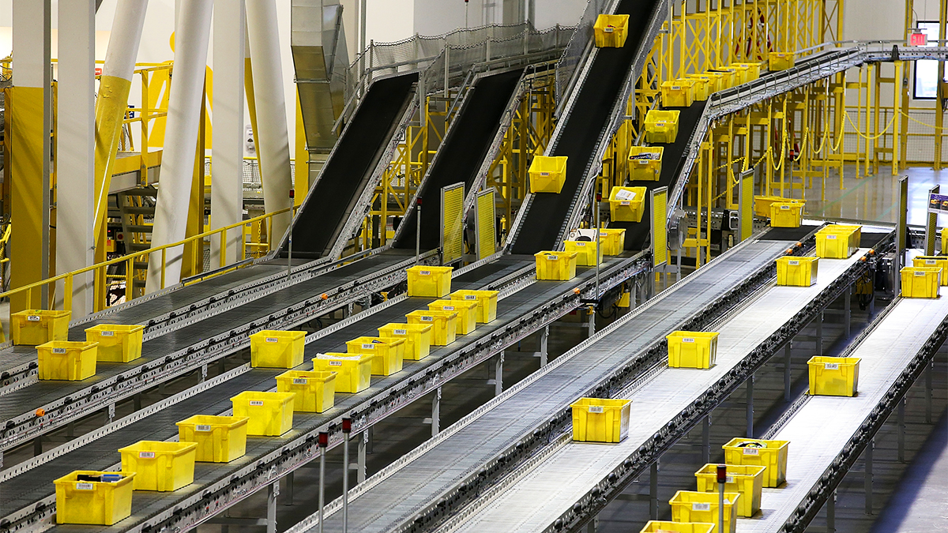
Why?
Increases Efficiency/Productivity
Saves Time and Money
Reduces Errors
Improves Consistency
Helps with Scalability
Enables data-driven decisions

Slide 3
Key Takeaway
Limitless Potential

Slide 4

Intro to Python
High-level interpreted language.
Easy to learn, read and understand.
Versatile – lots of use cases.
Web Development.
ML/AI.
Automation.
Extensive libraries and packages.
No ; or {} – easy syntax
Best Language Ever!

Slide 5
Python Flow Control
Hello World
Variables (Integers, Arithmetic Operations, Strings, Lists, Dictionaries)
User Input
If, else
Range
For
While
Functions
Open file

Slide 6
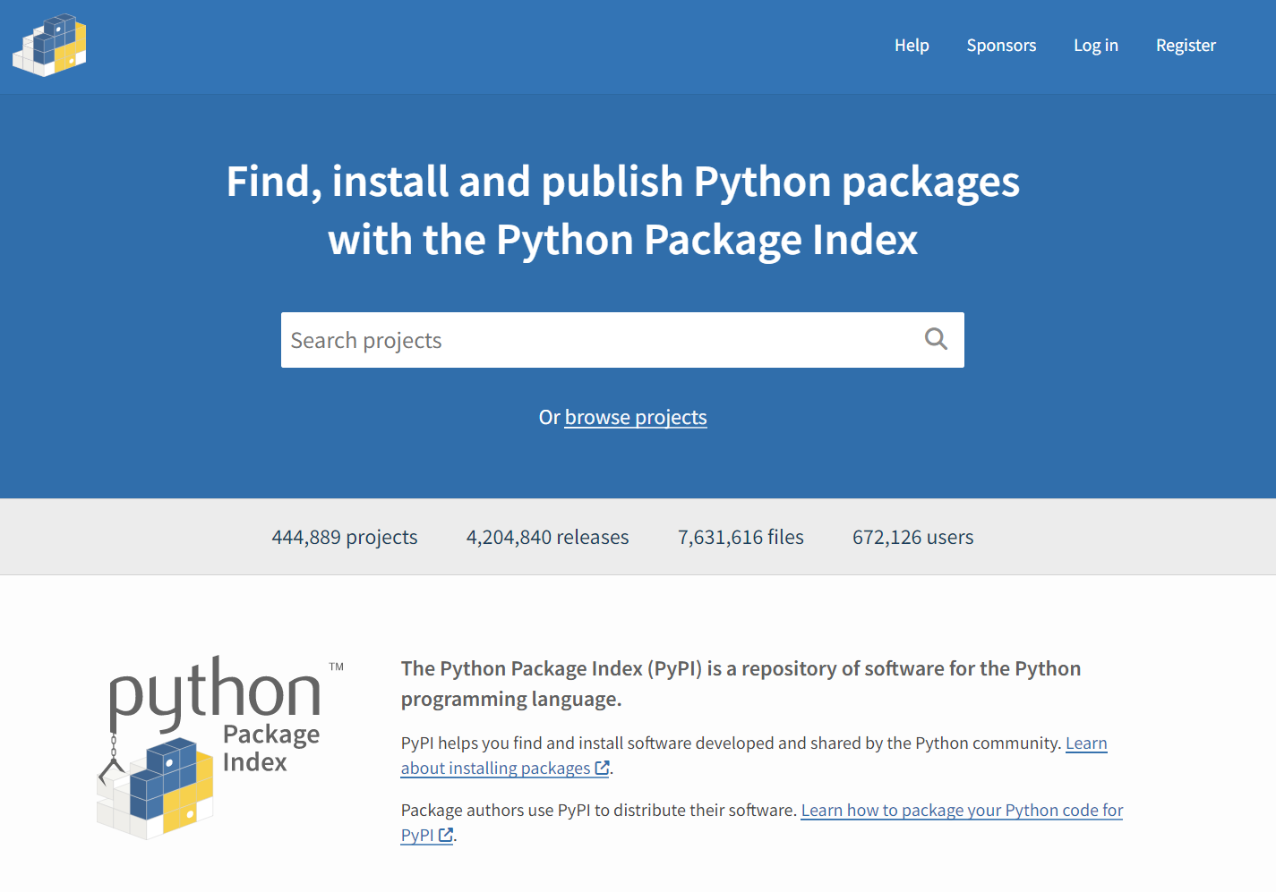
Python Packages
Easy-to-use libraries for every
possible use case.
Numpy, Pandas (Data Analysis)
SkLearn (Machine Learning/AI)
Pygame (Creating games), etc.
Q) What if I don’t know which package to use?
Ans) Google.com 💀
Ans) PyPI - https://pypi.org/
Secret Ans) ChatGPT

Slide 7
Code Example
Write a program that generates a random number between 1 and 100, and prompts the user to guess the number. The program should provide feedback to the user after each guess, telling them whether their guess is too high or too low. Once the user guesses the correct number, the program should print a congratulatory message along with the number of guesses it took.

Slide 8
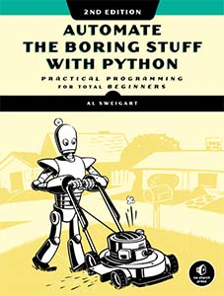
Automation with Python
Automate the Boring Stuff with Python
(Book by Al Sweigart) – Link
Our Focus
Web – Downloading & Scraping
Image Manipulation
CSV/Excel data Manipulation*

Slide 9
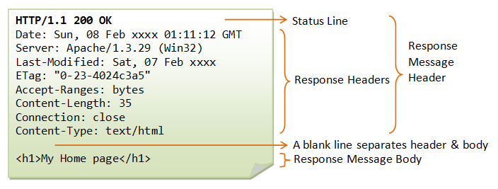
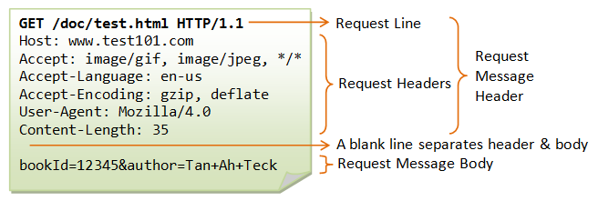
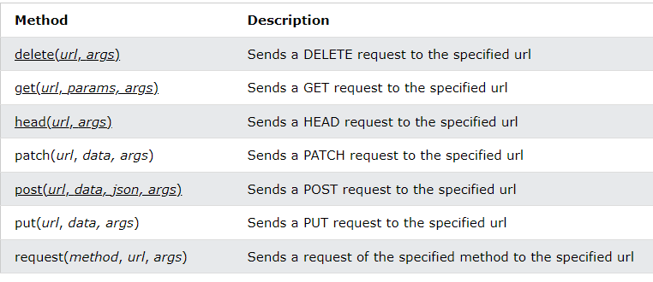
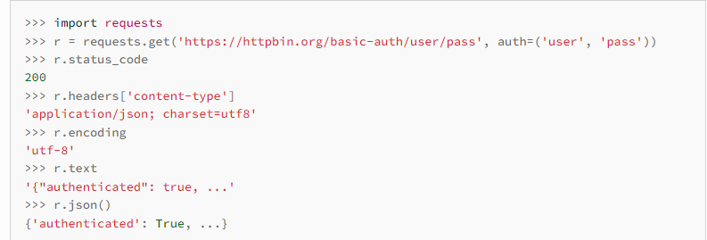
Requests Library
HTTP Request & Response

Slide 10

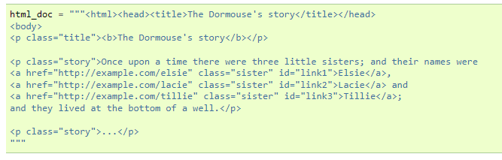
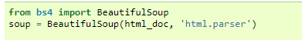
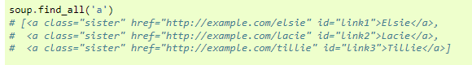
BeautifulSoup
A parser for pulling data out of HTML.

Slide 11
Web Download Challenge
Downloading multiple files given a URL pattern using requests.

Slide 12

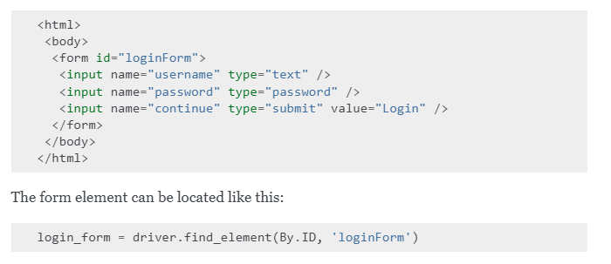
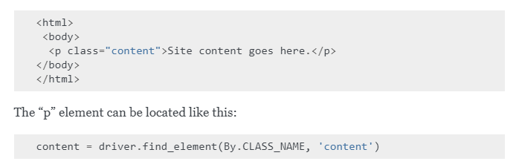
Selenium
Emulates a web browser, providing an API to automate web scraping.
Useful when HTML is not enough, clicks are required for navigation.
Locate elements by ID, Name, Xpath, Link Text, Class Name, CSS.

Slide 13
ASU Class Tracker
A web scraper built using Selenium to scrape the ASU Class search website and notify the user when the available seats go from 0 to 1 using Selenium.

Slide 14
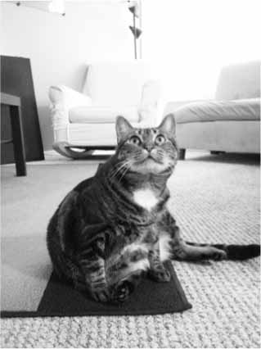
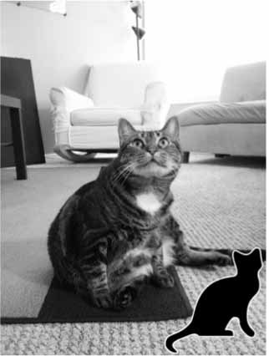
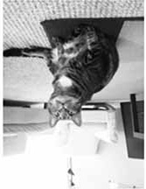
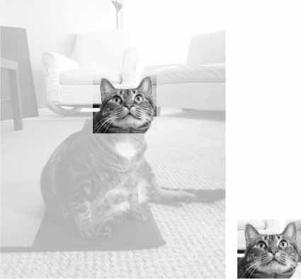
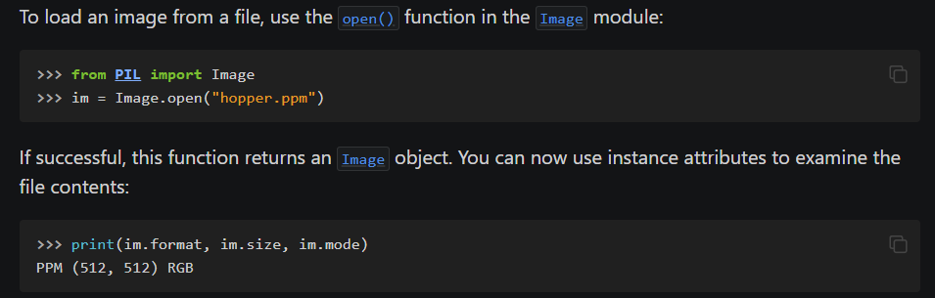
Pillow – Python Imaging Library
Pillow supports a variety of features:
Conversion into different file formats
Cropping Images
Merging Images
Resizing, Rotating, Flipping.
Overlaying Shapes/Images/Text

Slide 15
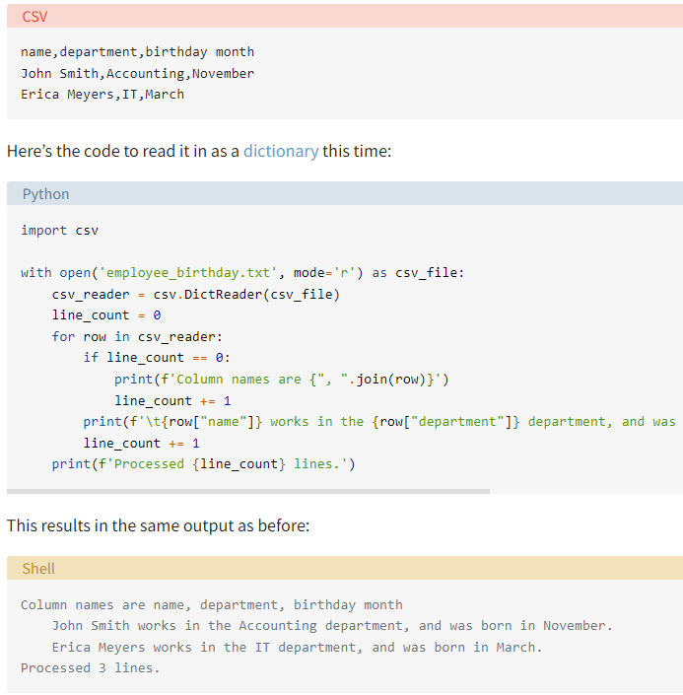
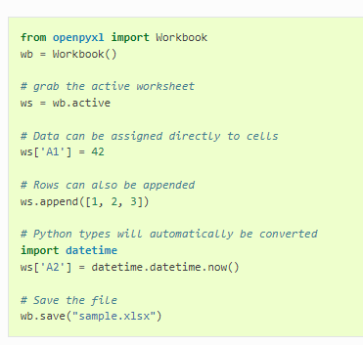
Excel/CSV files
OpenPyXL - Library to read/write Excel
Csv – Library to process CSV files.

Slide 16
Limitless Potential

Slide 17

Thank you!
Connect with me:

